Slide 1

Cars24 Data Analysis
Overview:
The purpose of this project is to analyze car pricing data to gain insights into trends, patterns, and factors influencing car prices in the market.
Aamir Rabbani
Gaurav Yadav
Parivesh Khatri
Ruchi Mishra
Sejal Prasad

Slide 2

Introduction
Significance of the Analysis
Brief introduction & Objectives
Analyzing car pricing data is crucial for several reasons:
Informed Decision-Making: It helps prospective car buyers make informed decisions by understanding market trends and pricing dynamics.
Competitive Advantage: For car sellers and dealerships, it provides insights into competitive pricing strategies and market positioning.
Market Insights: Industry stakeholders can gain valuable market insights to adapt their business strategies, forecast demand, and identify growth opportunities.
The dataset used in this project is sourced from Cars24, a leading platform for buying and selling used cars. It contains detailed information about various car models, including their prices, specifications, km_driven, owner type, and more.
The primary objective of this project is to analyze car pricing data to uncover trends, patterns, and insights that can be valuable for car buyers, sellers, and industry stakeholders.

Slide 3
Dataset overview
Overview
Key columns
Car Model
Car Name
Brand
Car Transmission
KM Driven
Owner Type
Fuel Type
Registration ID
Monthly EMI
Car Price
Down Payment Amount
Location
The dataset used for this analysis is sourced from Cars24, a prominent platform for buying and selling used cars. It comprises a comprehensive collection of data points related to various car listings available on the platform.
The dataset consists of 1103 rows and 13 columns.
It is structured in a tabular format, typically in CSV (Comma-Separated Values) or Excel format, facilitating easy data manipulation and analysis.

Slide 4
Methodology
Data Collection
(Web scraping with Python)
EDA
(With SQL queries)
Visualization
(Excel Dashboard)
The scraping process involves extracting relevant information from the website, such as car listings, prices, brands, models, mileage, and other attributes.
Through automation, the Python script navigates through the website's pages, collects the required data, and stores it in a structured format like CSV or Excel.
SQL (Structured Query Language) queries are used to extract insights and perform various analyses on the dataset.
SQL queries are crafted to filter, group, aggregate, and manipulate the data to derive meaningful insights. For example, querying average car prices by brand
Excel is utilized for creating interactive dashboards to visualize key metrics and trends in the car pricing data.
Pivot tables, charts, graphs, and other Excel features are employed to present the analysis findings in a visually appealing and comprehensible manner.

Slide 5
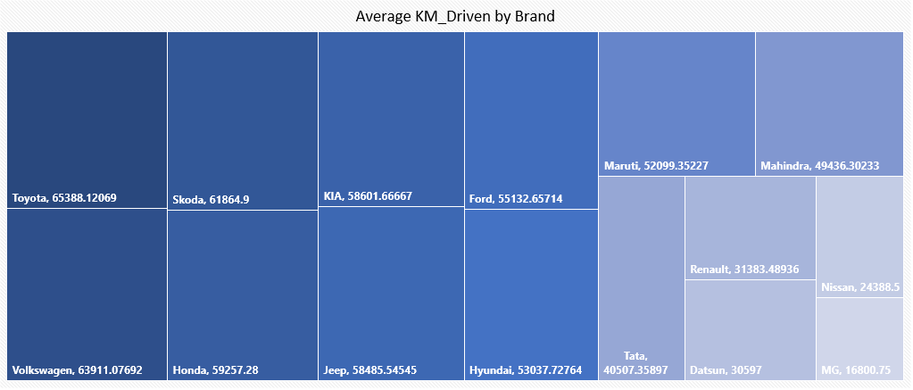
Insight_1
Comparing the average kilometers driven among the top car brands, Toyota emerges as a leader with users covering an annual distance of approximately 65388 km. This signifies the robustness and durability of Toyota vehicles. Whereas MG is at the most bottom position with an average of 16800km, respectively.

Slide 6
Insight_2
Comparing monthly EMI vs car price across different brands where MG has highest car price as well as monthly EMI and Datsun has the lowest price and EMI that means brands like MG may target affluent consumers seeking luxury and prestige, whereas Datsun may appeal to budget-conscious buyers prioritizing value for money.

Slide 7
Insight_3
The analysis highlights the variation in monthly EMIs across different brands and model years where Toyota has the highest monthly EMI in model year 2022 and Maruti has the lowest monthly EMI in 2010.

Slide 8
Insight_4
After analyzing sum of car prices by different brands and models it can be seen that Maruti has the highest total car prices in 2019 whereas Nissan has the lowest total car prices in 2012.

Slide 9
Insight_6
Insight_5
After analyzing least and most expensive cars by brand it can be seen that some brands may have higher average prices due to factors such as brand reputation, vehicle features, and market demand like as per the analysis Toyota has the most expensive cars and Maruti has the least expensive cars.
As per the analysis of fuel types Petrol is most preferable type among the people and least preferable fuel type is CNG. It means people are more user friendly with petrol cars.

Slide 10
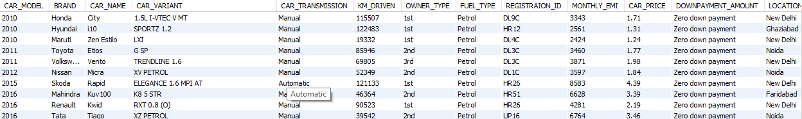
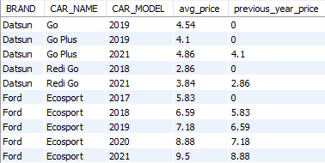
1. Can you provide information on the least expensive and most expensive cars for each brand available at CARS24, along with their specifications?
After analyzing least and most expensive cars by brand it can be seen that some brands may have higher average prices due to factors such as brand reputation, vehicle features, and market demand like as per the analysis Toyota has the most expensive cars and Maruti has the least expensive cars.
2. CARS 24 Manager wants you to compare the average prices of cars from each brand this year to those from last year.
After analyzing the data we came to know that average car prices are continuously increasing as compared to previous year car price for each car brand.

Slide 11
Conclusion
Summary
Challenges
In conclusion, some brands may have higher average prices due to factors such as brand reputation, vehicle features, and market demand like as per the analysis Toyota has the most expensive cars and Maruti has the least expensive cars.
It also concludes that as per the fuel types Petrol is most preferable type among the people and least preferable fuel type is CNG.
Following are the challenges that we have faced during the project analysis
To understand website structure
Understanding the HTML structure and identifying the specific elements to extract the data
Legal and ethical issues
Creating some meaningful insights
Lessons learned
Understanding data sources, Web scraping techniques, Data cleaning and preprocessing, SQL data analysis, Excel dashboard development, Presentation, Team work

Slide 12
After analyzing the Cars24 data through different columns like Brand, Car prices, Car emi, Fuel type, location etc; customers requirements can be understandable and based on that better services and offerings can be provided to the various customers as per their needs. Based on the analysis it can be suggested to expand into new markets, introducing new product lines, optimizing pricing strategies, improving customer service, and more.
Future work

Slide 13




Thank you

